Slide 1
Final Engagement
Attack, Defense & Analysis of a Vulnerable Network

Slide 2
Table of Contents
This document contains the following resources:
Network Topology & Critical Vulnerabilities
Traffic Profile
Normal Activity
Malicious Activity

Slide 3
Network Topology
& Critical Vulnerabilities
‹#›

Slide 4
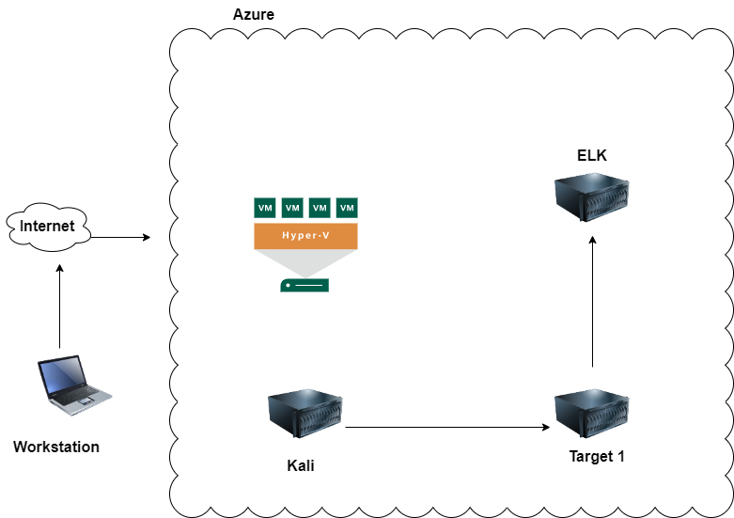
Network Topology
Network
Address Range:192.168.1.0/24
Netmask:255.255.255.0
Gateway: 192.168.1.1
Machines
IPv4:192.168.1.110
OS: Linux
Hostname: Target 1
IPv4:192.168.1.90
OS: Linux
Hostname: Kali
IPv4: 192.168.1.100
OS: Linux
Hostname: Elk

Slide 5
Critical Vulnerabilities: Target 1
Our assessment uncovered the following critical vulnerabilities in Target 1.
Vulnerability | Description | Impact
Nmap | Nmap was used to view open ports. | Discovered open ports, OS versions and services
WPScan | WPScan was used to gain user information. | Acquired two user names using WPScan
Weak Password/Easily Cracked Hash | Password for user michael was the same as his UID. User steve has a short password that was easily cracked using John the ripper. | Used michael’s password to connect to the machine via ssh and then found password hashes in the wp database.
Python Privileges | User steven has sudo privelege without a password for Python | Able to escalate to root using steven’s account.

Slide 6
Traffic Profile
‹#›

Slide 7
Traffic Profile
Our analysis identified the following characteristics of the traffic on the network:
Feature | Value | Description
Top Talkers (IP Addresses) | 185.243.115.84 - 16 M bytes 172.16.4.205 - 15 M bytes | Machines that sent the most traffic.
Most Common Protocols | TCP 88.5 % of packets UDP 11.2 % of packets | Three most common protocols on the network.
# of Unique IP Addresses | 808 | Count of observed IP addresses.
Subnets | 185.243.115.0/24 172.16.4.0/24 10.0.0.0/24 10.6.12.0/24 | Observed subnet ranges.
# of Malware Species | (1) june11.dll | Number of malware binaries identified in traffic.
Notes:
You may have more than 2 subnets.

Slide 8
Behavioral Analysis
Purpose of Traffic on the Network
Users were observed engaging in the following kinds of activity.
“Normal” Activity
Accessing reasonable websites, and sending work related traffic with some instances of unrelated traffic
Suspicious Activity
Accessing torrenting websites, routing traffic through non-authorized servers, downloading malware

Slide 9
Normal Activity
‹#›

Slide 10
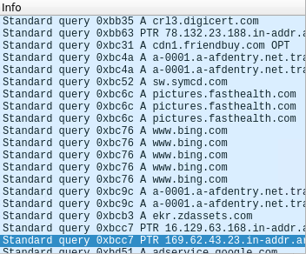
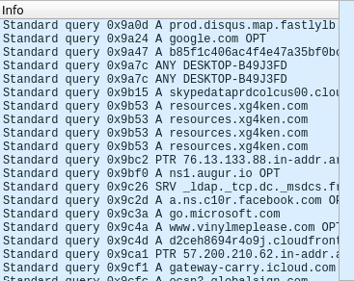
Normal Traffic: Web Browsing
Summarize the following:
Normal traffic may look like common web browsing
This is harmless as long as it doesn’t lead to malicious actions, intentional or not

Slide 11
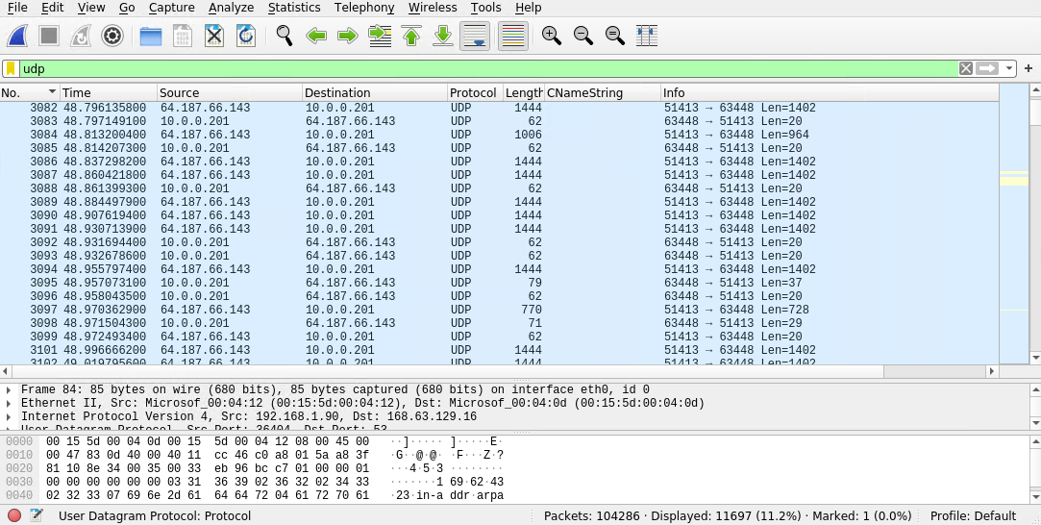
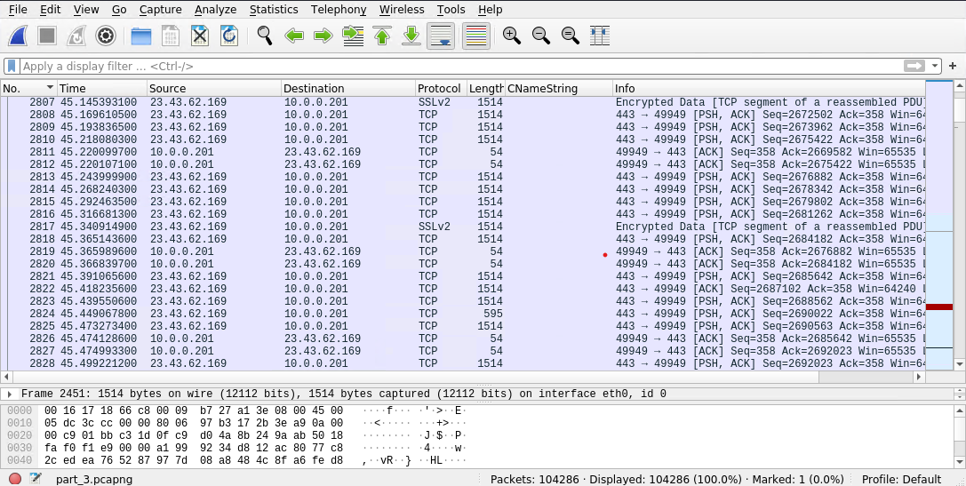
Normal Traffic: Downloading, Uploading Harmless Files
Typical traffic can look like downloading and uploading files, such as below.
These take place through TCP and UDP protocols

Slide 12
Malicious Activity
‹#›

Slide 13
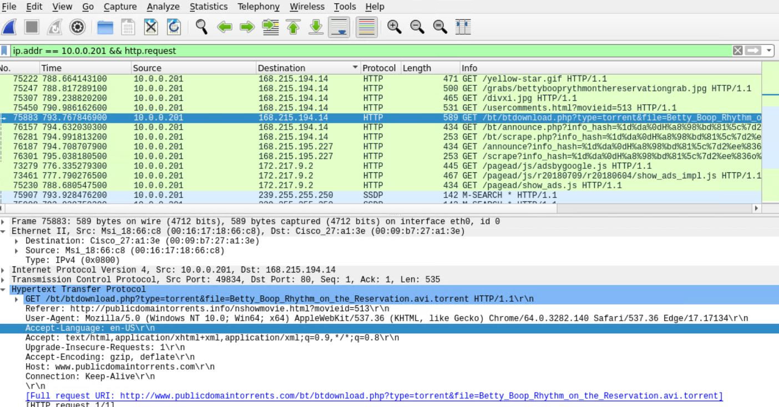
Pirating a Movie
Summarize the following:
What, specifically, was the user doing? Which site were they browsing?.The user was downloading unauthorized torrent movies from publicdomaintorrents.com.
.
This slide shows the user on publicdomaintorrents.com and what movie he was downloading. The movie title is, “Betty Boop Rhythm on the Reservation”.

Slide 14
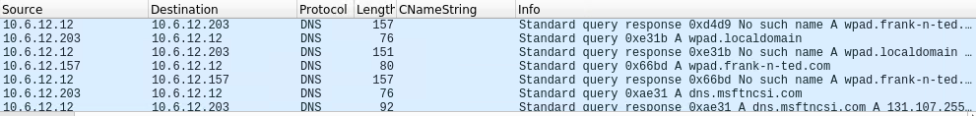
Setting up an Unauthorized Server
Summarize the following:
The users utilized a server that routed traffic through DHCP, DNS, CLDAP, TCP, SMB2, and other protocols
They used this server to access frank-n-ted.com

Slide 15
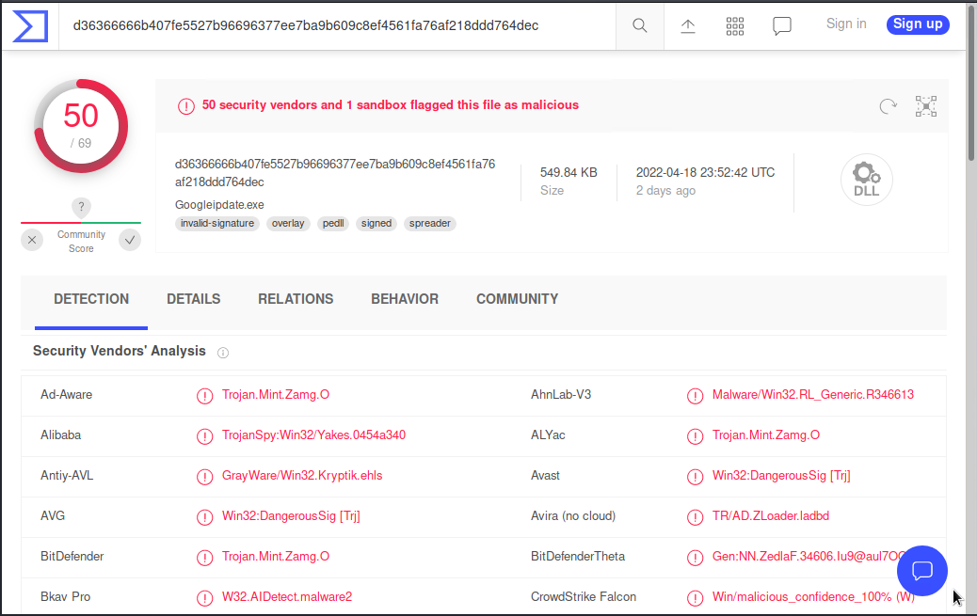
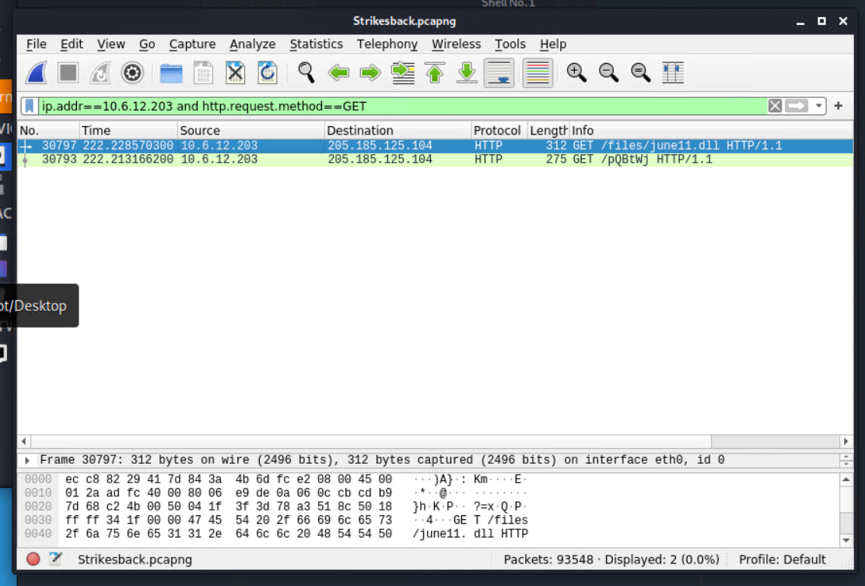
Downloading a Trojan
Summarize the following:
Frank and Ted, through their unauthorized server, downloaded a suspicious file named june11.dll
This file was discovered to be a trojan

Slide 16
The End
‹#›

